Slide 1
CS 107: Computer Architecture and Organization
SBCC
Spring 2020

Slide 2
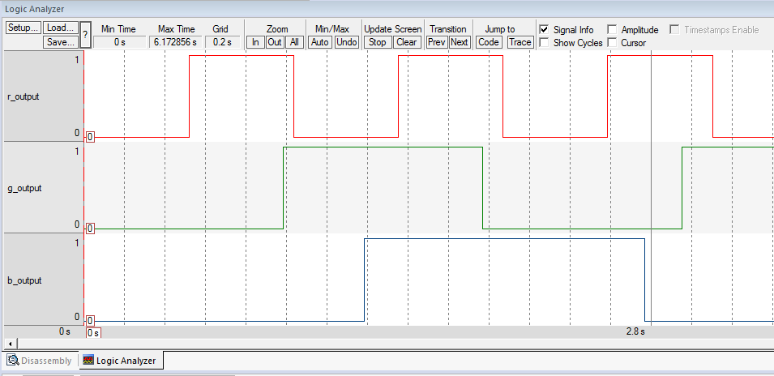
Logic Analyzer
The Logic Analyzer is a graphical analysis tool that shows value changes of variables. These elements can be specified by the user, but are subject to restrictions. As a consequence, not every variable can be shown.
The Logic Analyzer can be used with the Simulator or with Cortex-M devices that provide trace.

Slide 3
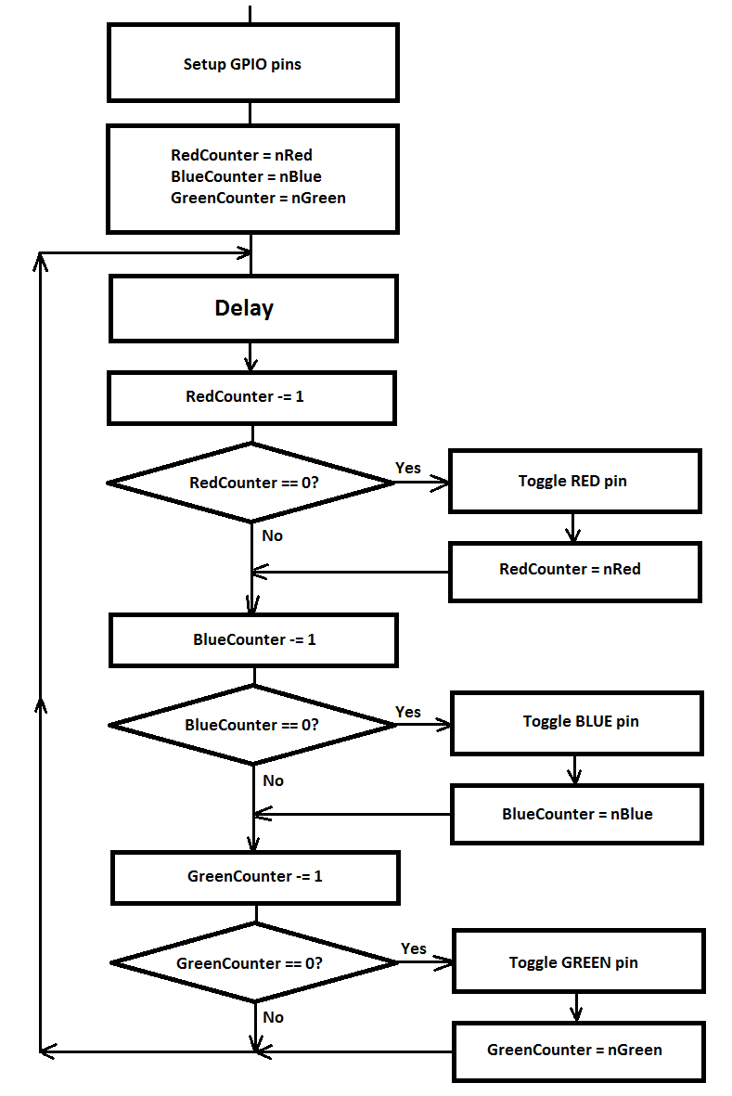
Logic Analyzer
Lab05 Part B
We will use ‘variables’ ‘r_output’, ‘g_output’ and ‘b_output’ instead of GPIO pins.
We will see our results in ‘Analyzer’.
You will use ‘Analyzer’ for your next Labs.

Slide 4
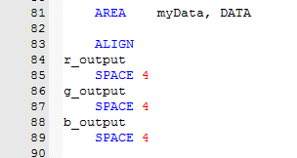
Logic Analyzer
1. Create ‘variables’ in DATA memory.
(Variables can not be placed into FLASH memory because we need to change values of variables. We can not change FLASH!
DATA memory
3 32-bit variables (4 bytes per variable. 32/8 = 4)

Slide 5
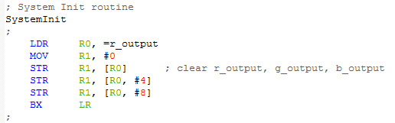
Logic Analyzer
2. Setup GPIO pins.
Instead of setup GPIO pins we will clear variables. We can do it in ‘SysInit’ function.
Use ‘base-offset’ method.
R0 is base address
R1 is 0 to store into variables
#4 and #8 are offsets for g_output and b_output (because size of each variable is 4 bytes)

Slide 6
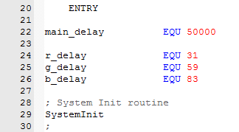
Logic Analyzer
3. We have to set constants for ‘main delay’ and for Red, Green and Blue counters.
Use ‘EQU’ assembler command.

Slide 7
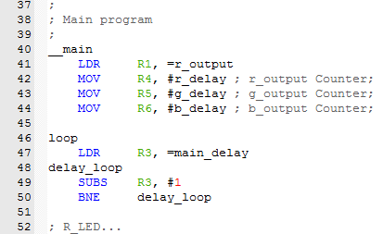
Logic Analyzer
4. Set initial values for ‘base address’ and for counters, Label for loop and delay…
R1 – ‘Base address’ for variables.
R4, R5 and R6 – counters for Red, Green and Blue.
‘loop’ is the label for loop.
‘delay’ is simple.

Slide 8
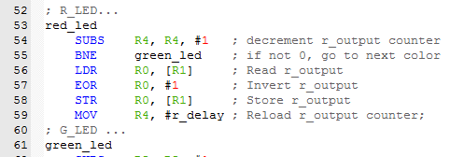
Logic Analyzer
5. Red channel…
RedCounter = RedCounter – 1
if (RedCounter = 0):
r_output = r_output ^ 1 # XOR
RedCounter = nRed
RedCounter is R4.
Use ‘SUBS’ to set flags.
If R4 = R4 – 1 not 0, going to next ‘color’.
Use ‘read-write-modify’ method to ‘toggle’ variable.
R1 is the address of r_output.

Slide 9
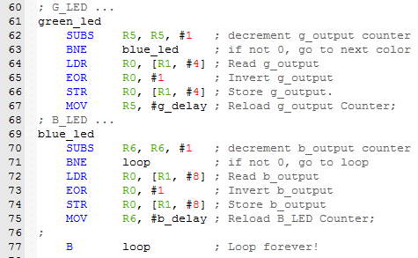
Logic Analyzer
6. Green and Blue channels…
The same technique as for ‘Red’. Using R5, g_output, g_delay and R6, b_output, b_delay instead of R4, r_output and r_delay.
Using ‘base-offset’ method for g_output and b_output. Offsets are 4 and 8 (32-bit variables). Base address is R1 (address of r_output).
No ‘next color’ for Blue, going to begin of the loop.

Slide 10
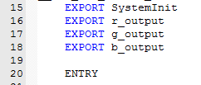
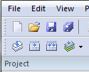

Logic Analyzer
7. Set r_output, g_output and b_output as Global variables…
Analyzer can work only with ‘global’ variables.
Compile
Load into debugger

Slide 11
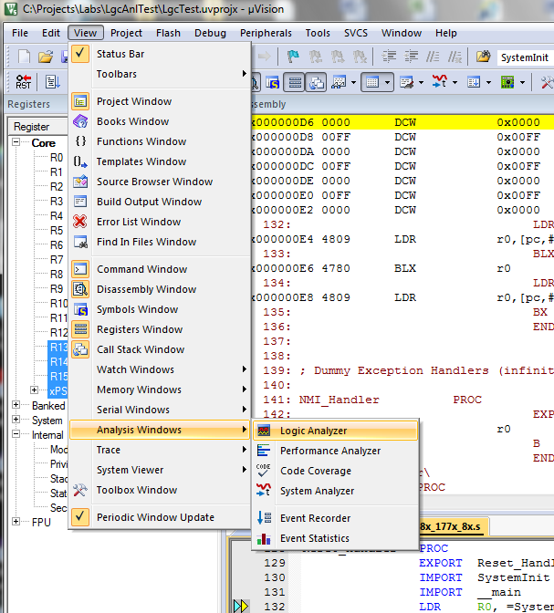
Logic Analyzer
Open Analyzer window
View
Analysis Windows
Logic Analyzer

Slide 12
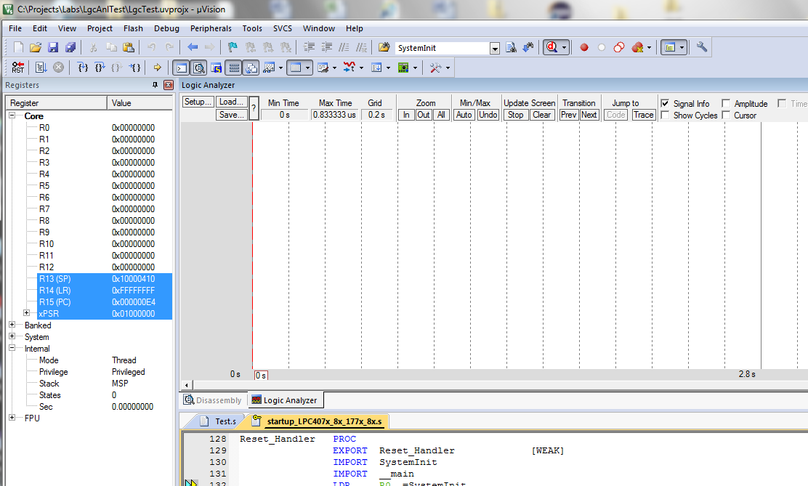
Logic Analyzer
Setup variables to show

Slide 13
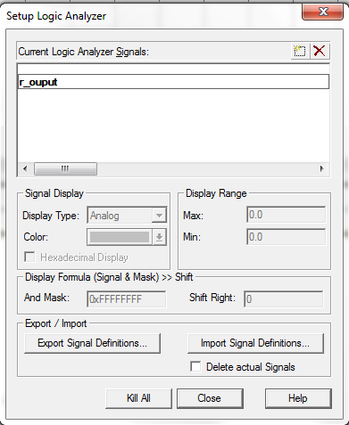
Logic Analyzer
‘Add’ button
Type name of variable (r_output),
Press ‘Enter’.

Slide 14
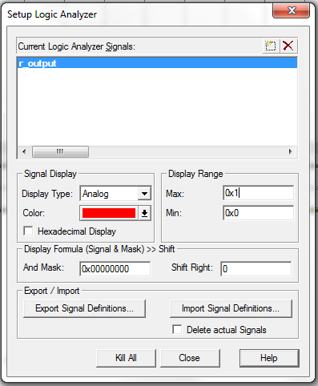
Logic Analyzer
Change the color
(Red for r_output)
Set Minimum and Maximum values to display.
Unsigned numbers.
Hexadecimal or decimal
0x0 … 0xFFFFFFFF

Slide 15
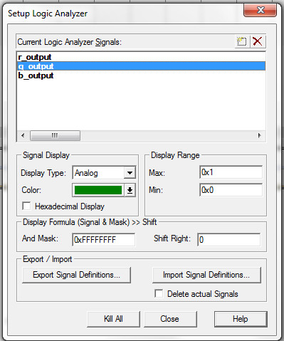
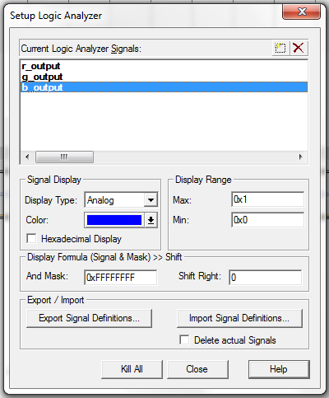
Logic Analyzer
Save settings

Slide 16
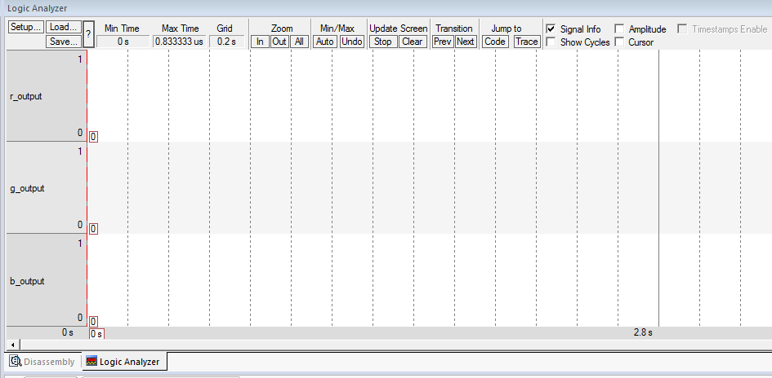

Logic Analyzer
Run the simulator…

Slide 17
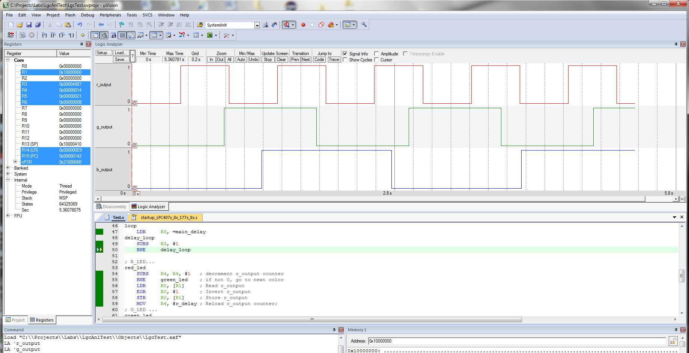
Logic Analyzer

Slide 18
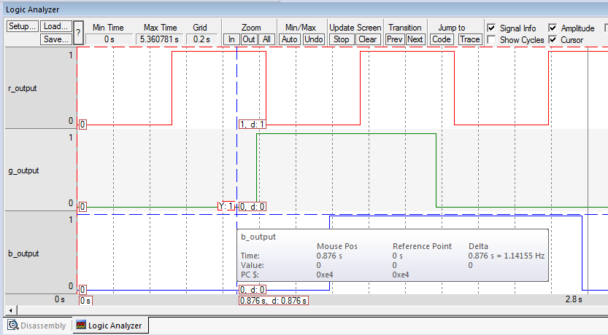
Logic Analyzer
Cursor
Signal Info
Cursor
Signal Info

Slide 19
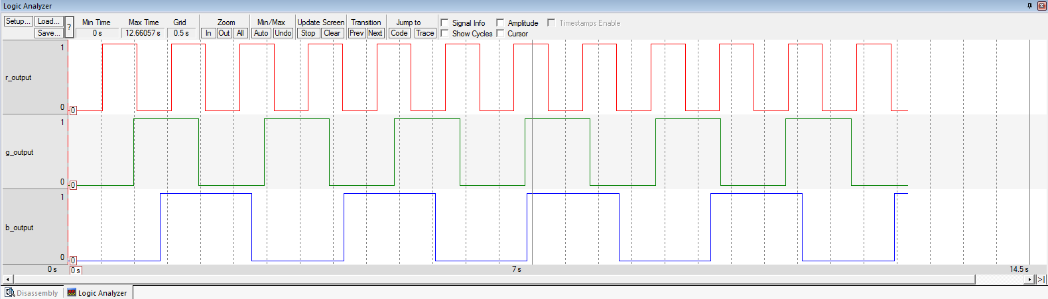
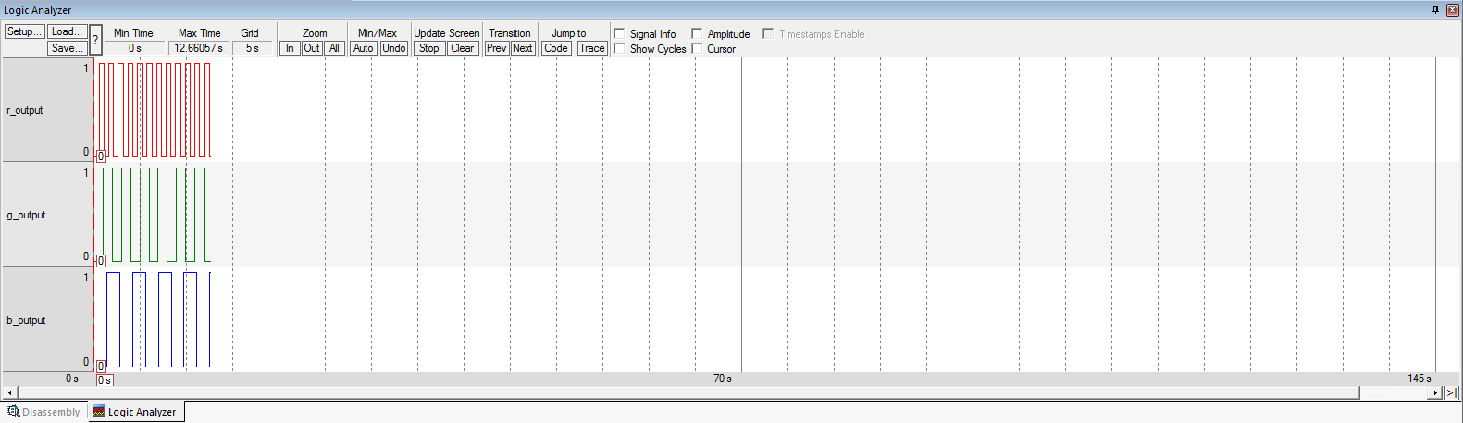
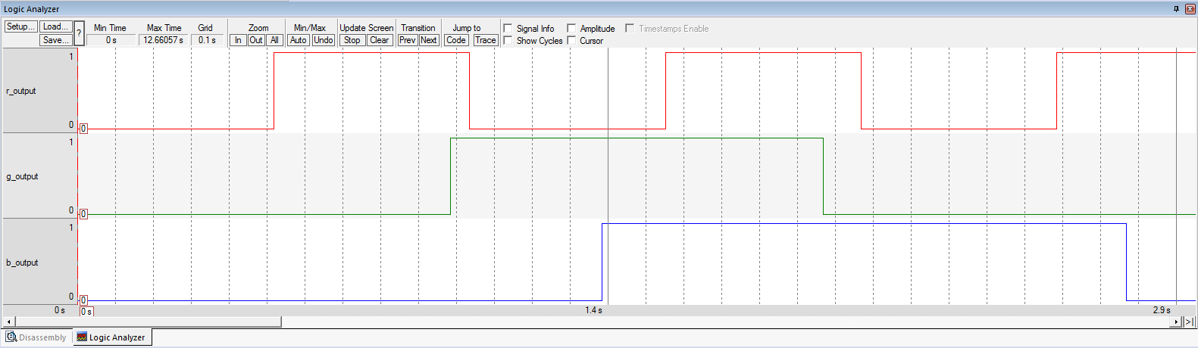
Logic Analyzer
Zoom
All
Out
In

Slide 20
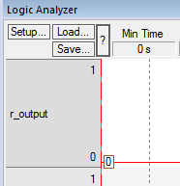
Logic Analyzer
You can Save and Load yours Analyzer’s settings.
LAB 8
Logic Analyzer
(Simulator!)

